Slide 1
An Introduction to Functional 3d Printing Design
Keith Chester
@thekeithchester
github.com/hlfshell

Slide 2

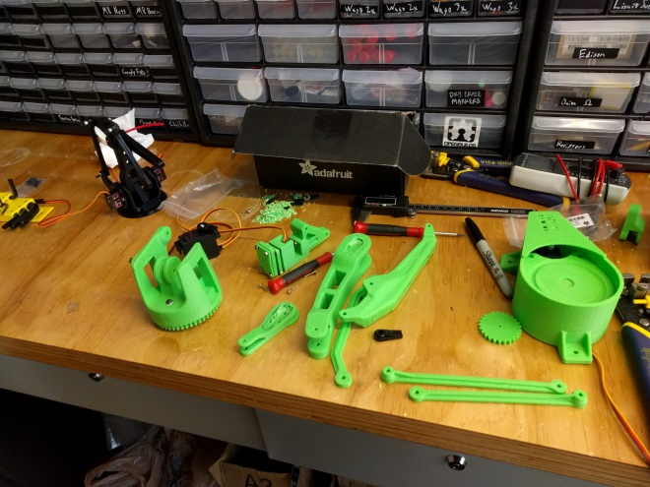
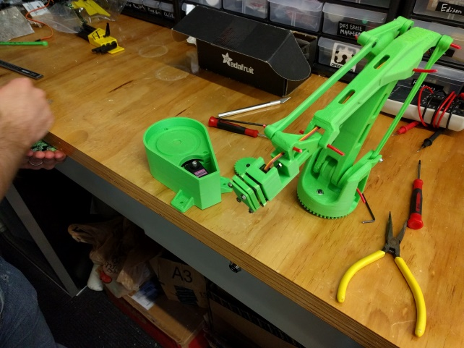
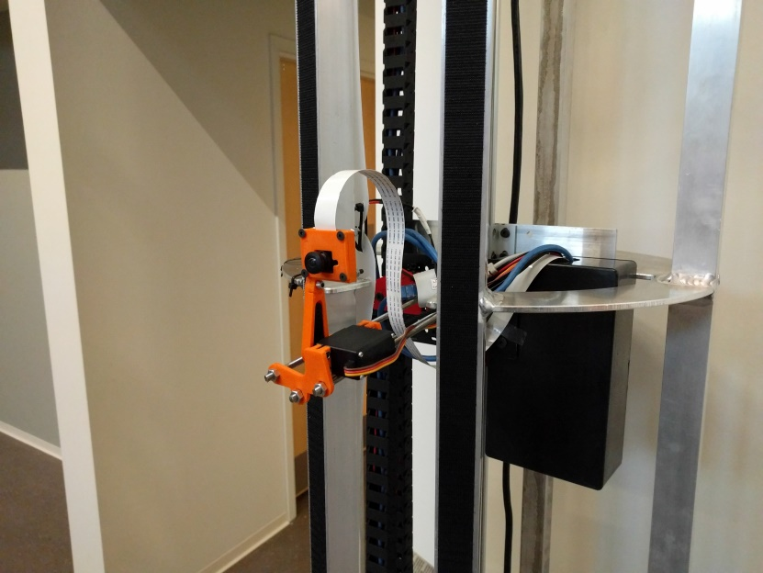

Who am I

Slide 3
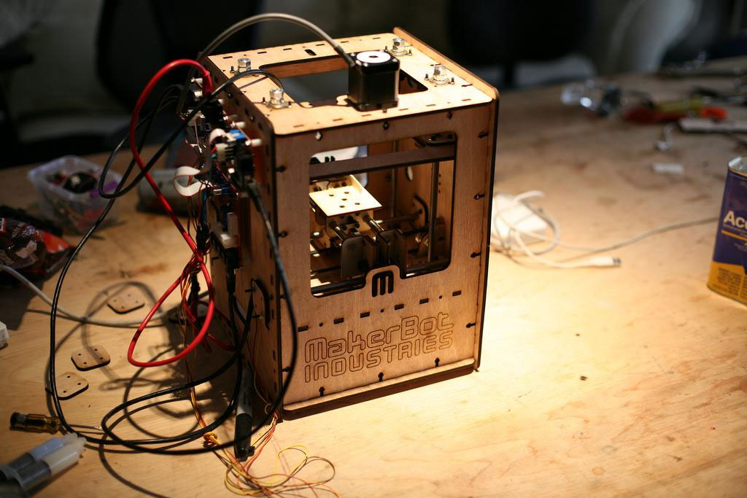
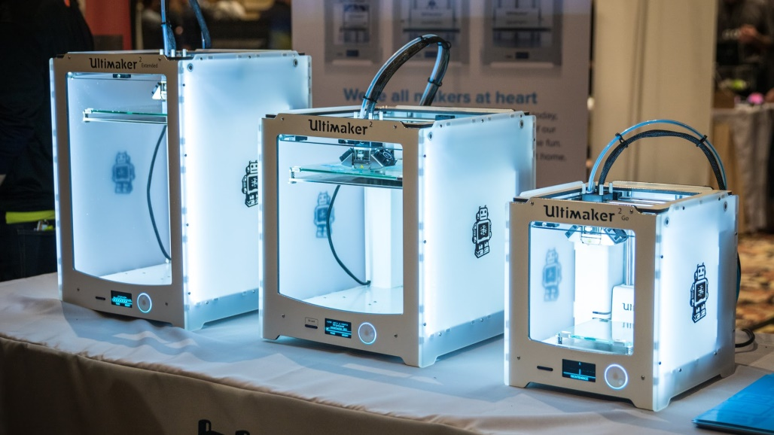
Beyond the Hype – 3d printing is a tool
3d printing received a ton of hype during its heyday
Great! It took us from
to
…this has caused some problems though – some people get 3d printers without knowing what they’re going to use them for

Slide 4
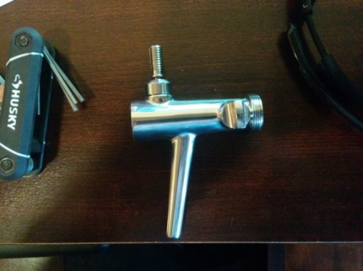
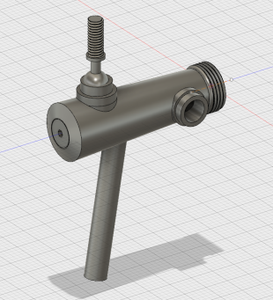
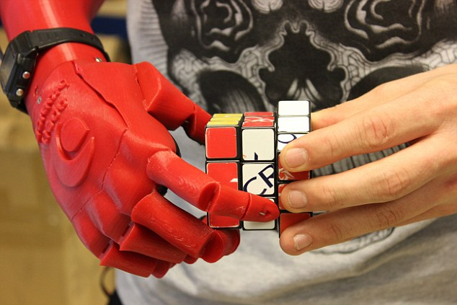
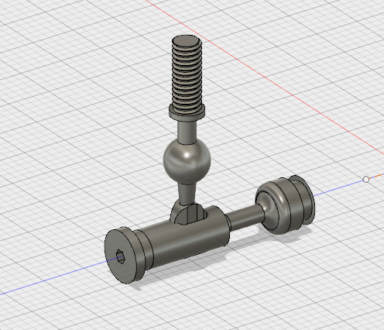
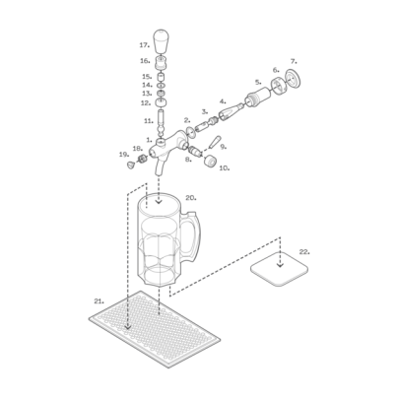
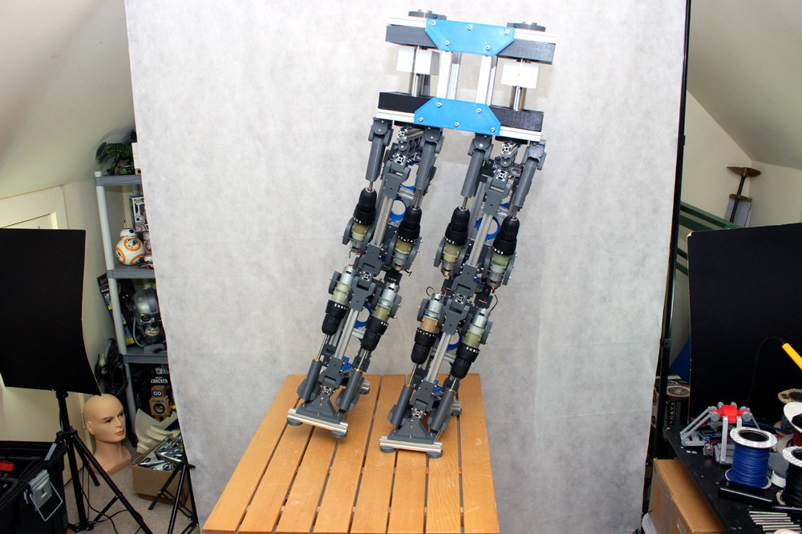
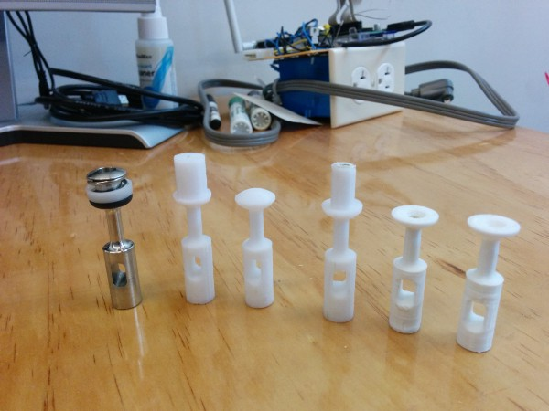
What they are good at

Slide 5
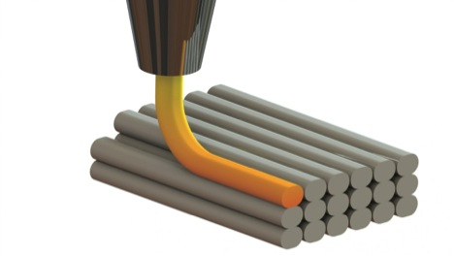
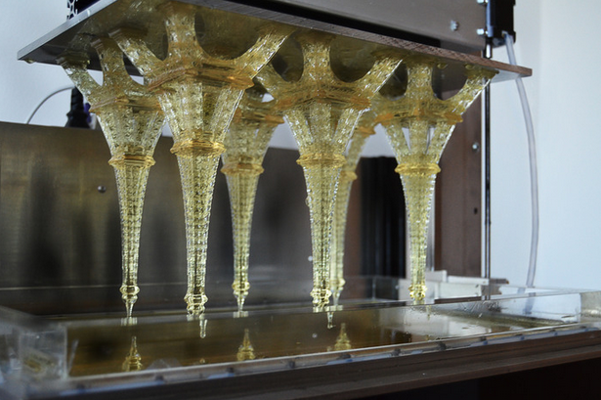
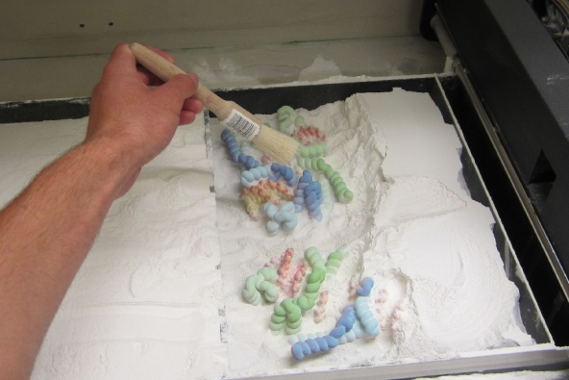
Types of 3d printers
FDM
Resin
Powder

Slide 6
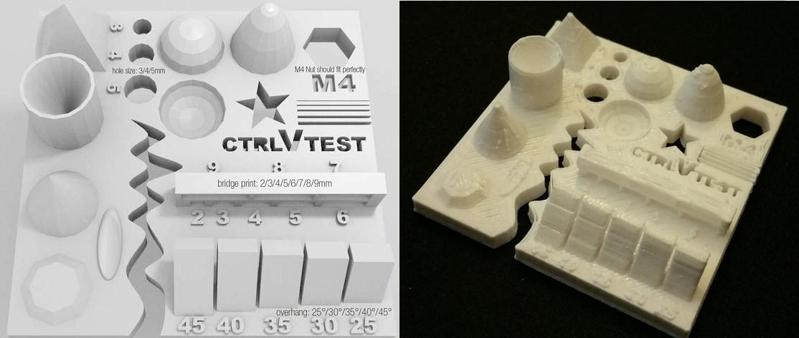
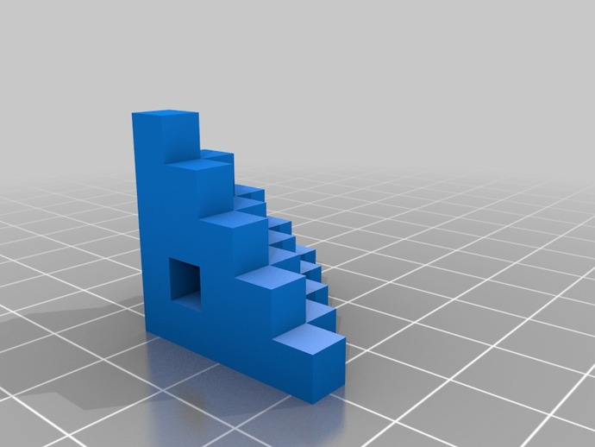
Dimensional Accuracy
Testing and calibrating is important, but will never be perfect in affordable machines due to
open-loop machines. KNOWING your inaccuracies in each axis is important

Slide 7
Exact fit – don’t do it
Fitting exact fit never works
You need to put additional spacing for your hole / slot / embed space to connect parts

Slide 8
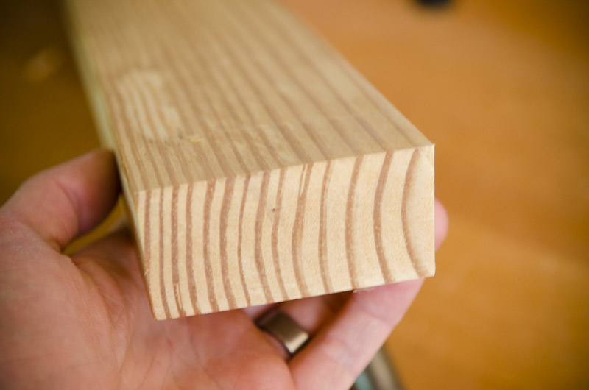
Strength of prints – it’s all in the layers

Slide 9
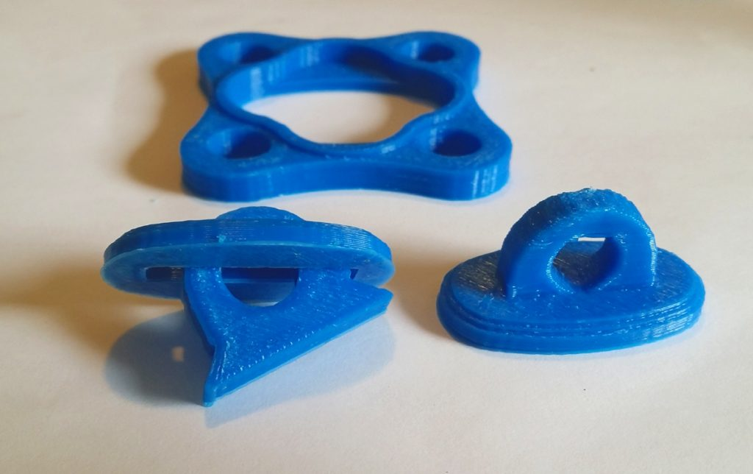
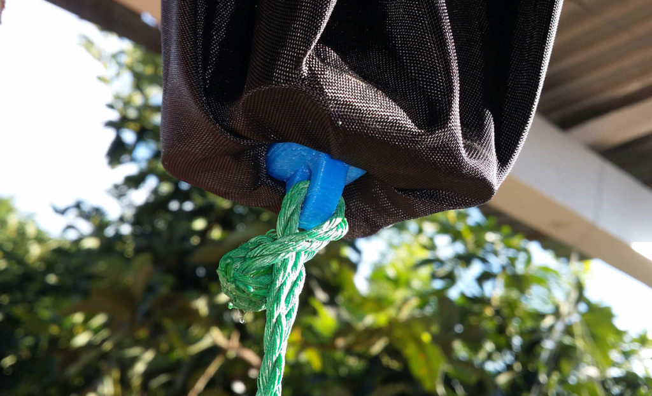
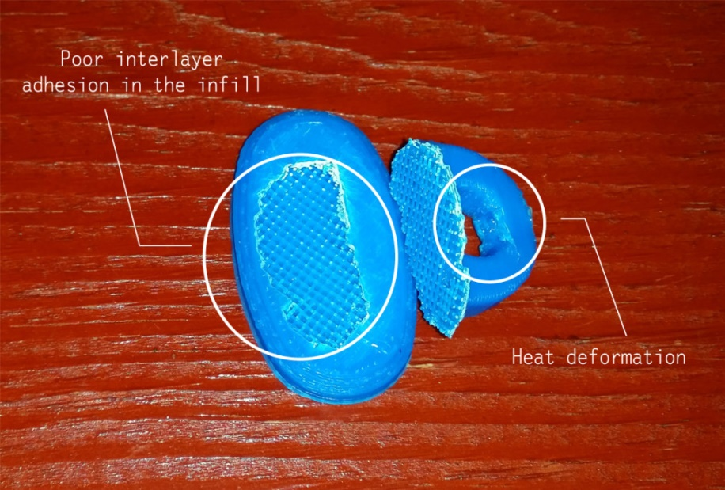
Layer Strength
37 lbs
70+ lbs
* from Functional Design For 3D Printing by Clifford Smyth

Slide 10
Effect of infill on strength
Honeycomb – slow to print, good Z-axis strength, good rigidity light weight – shoot for 35%
Rectilinear – good tensile strength, moderate flexibility – shoot for 25%
Line – low rigidity, light weight, weak. Speed prints only

Slide 11
Material Differences
PLA
ABS
Ninjaflex / SemiFlex
Cheetah
HIPS
Metal “fill” PLAs
Taulman3d – Nylon, Alloy 910, Bridge
ColorFab-XT and other copolyesters

Slide 12
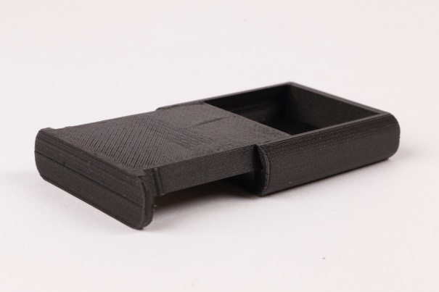
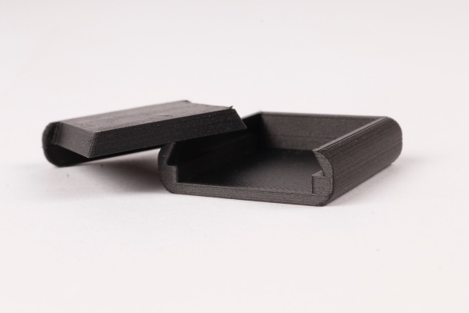
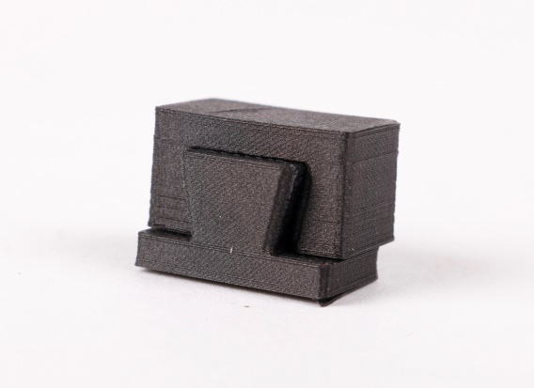
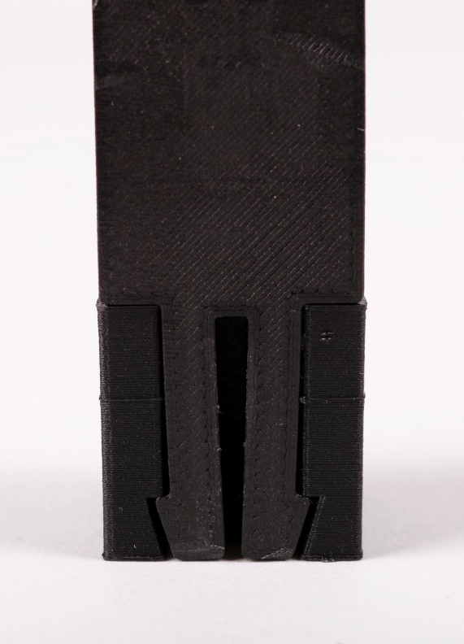
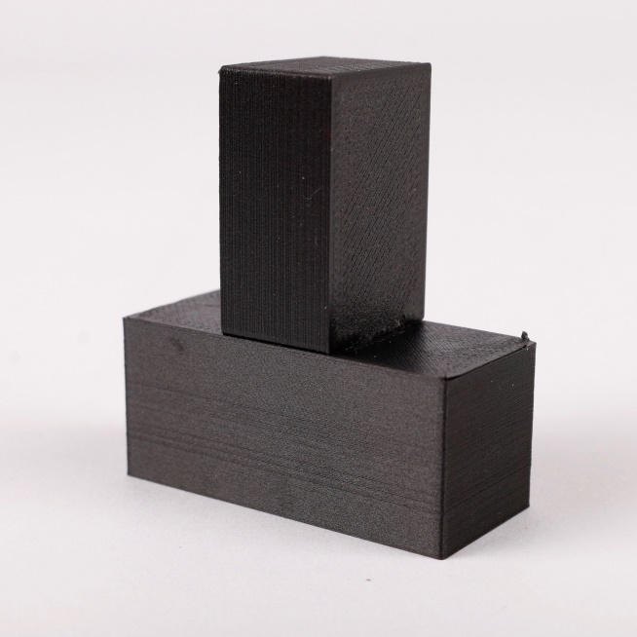
3d Printed Joinery

Slide 13
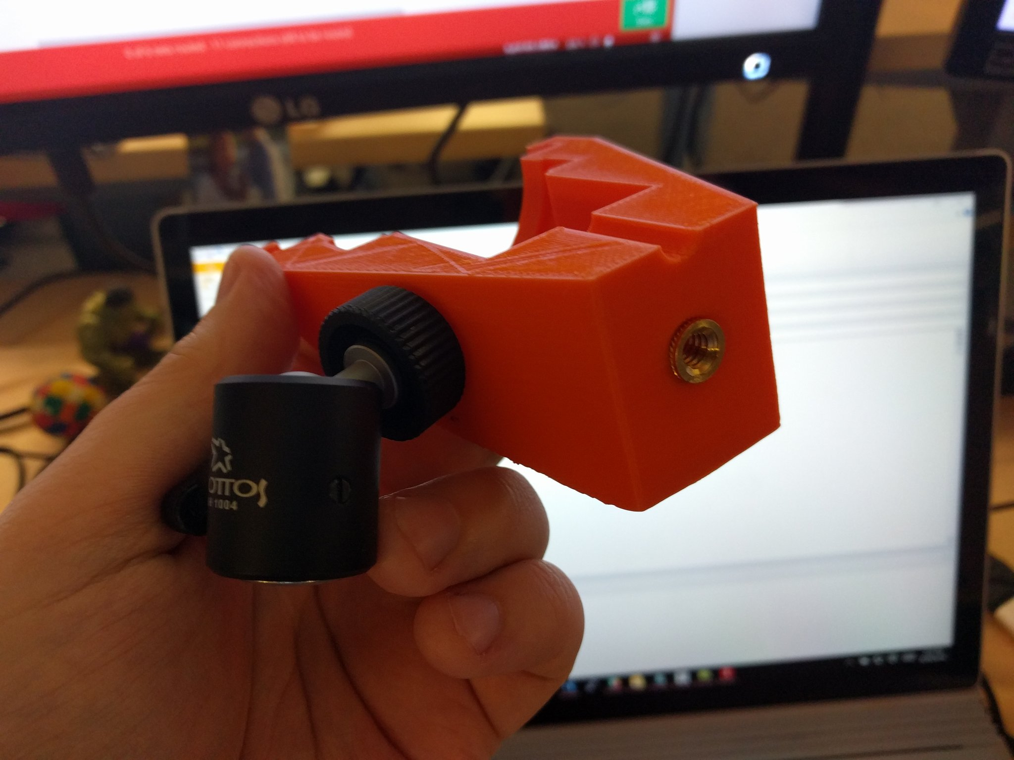
Threaded Inserts

Slide 14
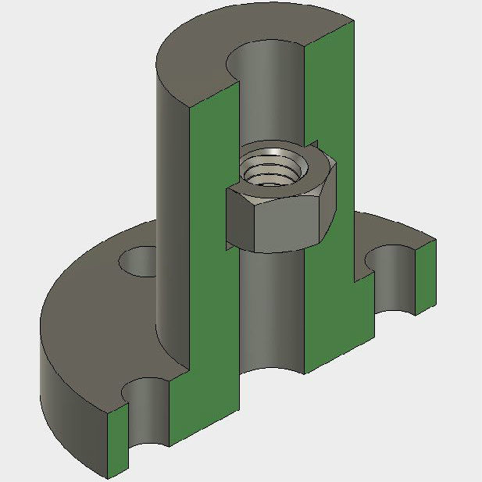
Captive nuts

Slide 15
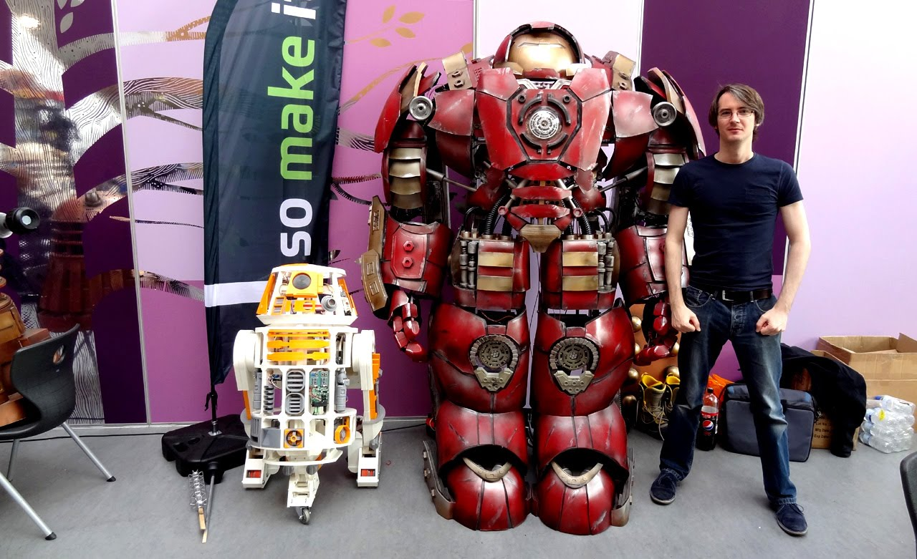
Resources
Fusion360 - free for students/startups
Slack – I can be found in TechSTL
James Bruton – genius of 3d printing robots + cosplay suits

